Slide 1
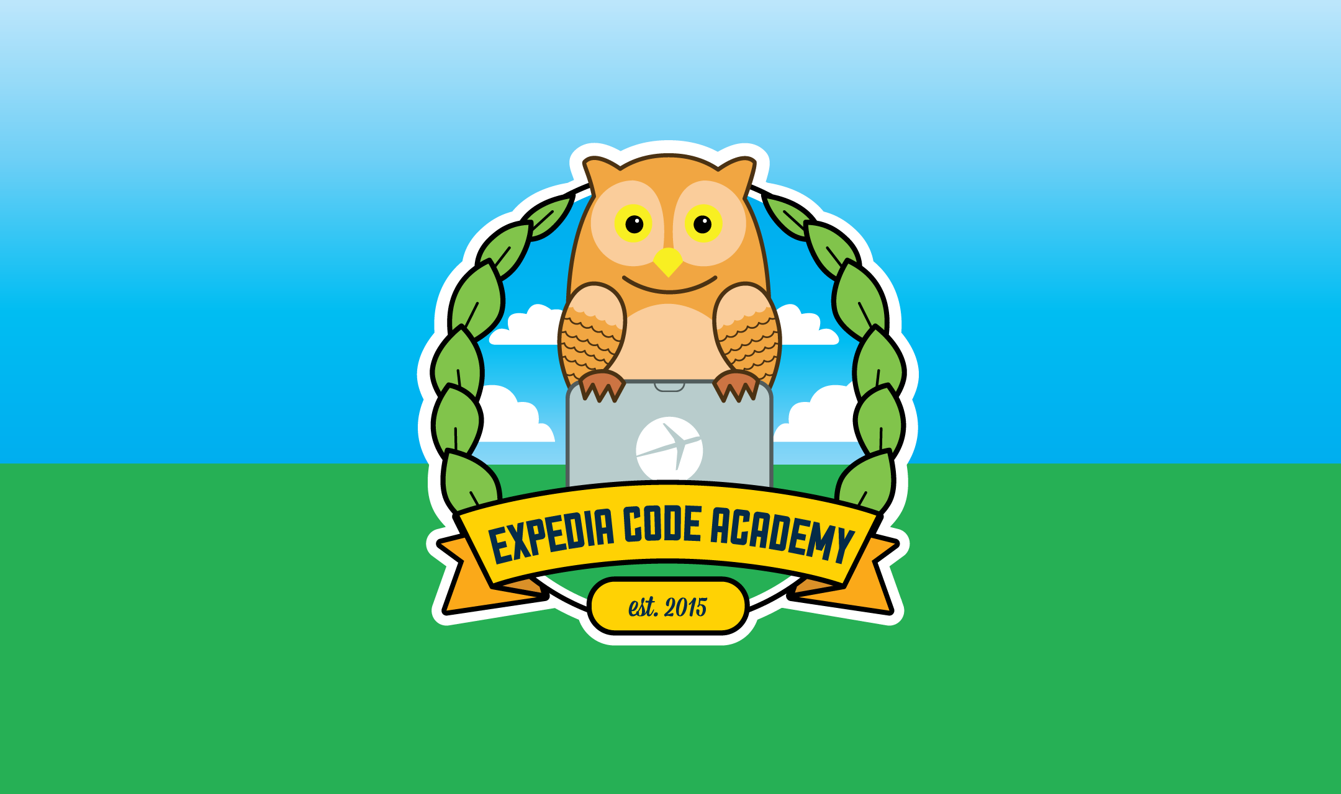
Python as an Additional Language
Session 1: Getting up to speed

Slide 2

About this Course
Who am I?
Who are you?
Course Aims

Slide 3
Other languages – Differences?
Strong typing
Can’t treat one variable as a different type without casting
Dynamic Typing
Can reassign the type of a variable at any time
Semantic whitespace
No braces or end statements ( if… else… fi… ) etc

Slide 4
Python 2 or 3?
Realistically, little differences between the two:
Everything is in unicode
print() is a function not a statement
Enforcement of tabs vs spaces
Python 3 only fully supported in CPython at the moment.
Jython, IronPython, PyPy etc: 2.7
So we’ll stick with Python 2 for now.

Slide 5
What we need
Python (obviously!)
An editor / IDE.
PyCharm / IntelliJ
Visual Studio Code
Vim
… pick your own!

Slide 6
First steps:
What will each of these do? (Don’t type them in yet!)
>>> print 'Hello, World!'
>>> 1 + 1
>>> 2 * 3
>>> 9 / 2
>>> number = 3
>>> print "My number is: " + number

Slide 7
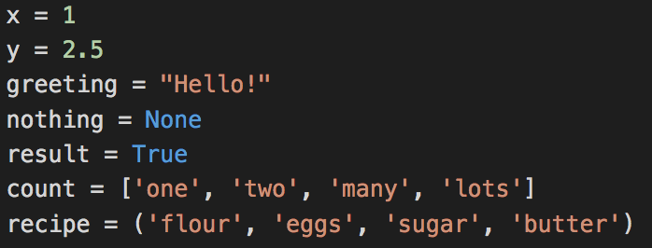
Basic Data Types
All the ones you’d expect, and perhaps a couple you wouldn’t.

Slide 8
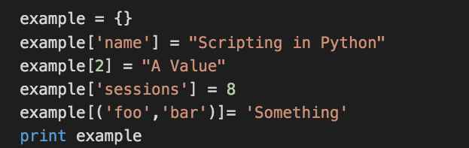
More complex data types: Dictionaries
Key/Value store
Key and value can both be various types of object:

Slide 9
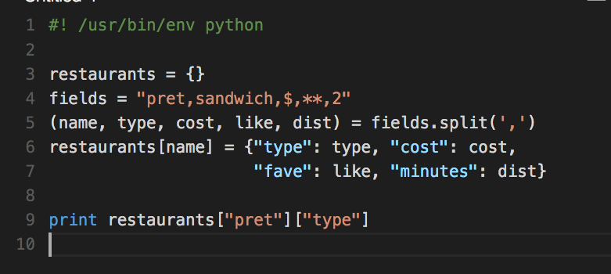
What does this code do?
What is going on internally?

Slide 10
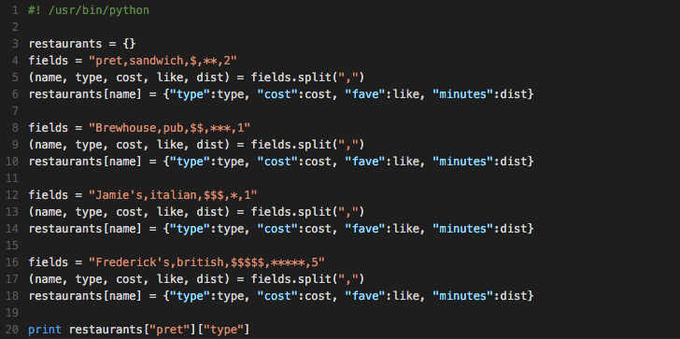
Let’s add some more options

Slide 11
What next?
Add a way for your program to print out the type of a restaurant if you input its name
Here’s a hint:
Next week: Separating the data from the program
Questions? Comments? Come see us in S32, on Monday, 11:00 – 12:00

